Slide 1
Configuration of interspec templated specifications

Slide 2
Contents
Background
How to templates work?
How to generate templates for a single level report
How to generate templates for a multi level report

Slide 3
Background
In Interspec we store specifications which hold all data for a specification. This means we have a lot of customers for the same specification, all need a slightly different set of data. A templating approach is chosen to limit the amount of reports to maintain by IT and offer agility towards new requirements.

Slide 4
Single level reports: Targeted specification Specification overview

Slide 5
Templates:
A template is a specification that only exists to steer the report. It is typically build on the same/simular frame as the specification to be reported.
General rule: In case the template contains a property with a value at a specific header, this property/header combination will be shown in the report. All properties that are “checked out” in the report or have no data will be neglected. Exception are the properties from the “Config” section.
BoM section is shown in case a BoM header exists
The config section is a section that is hidden from most users in Interspec and used for technical purpose. As the people creating templates cannot see/change the data in this section (automatic fill of by customisation), there is now way to make it vanish from the report

Slide 6
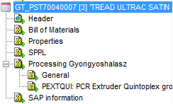
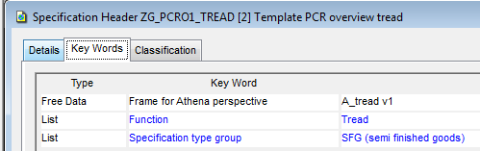
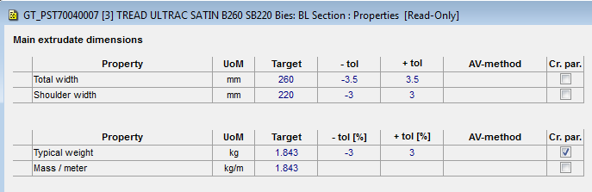
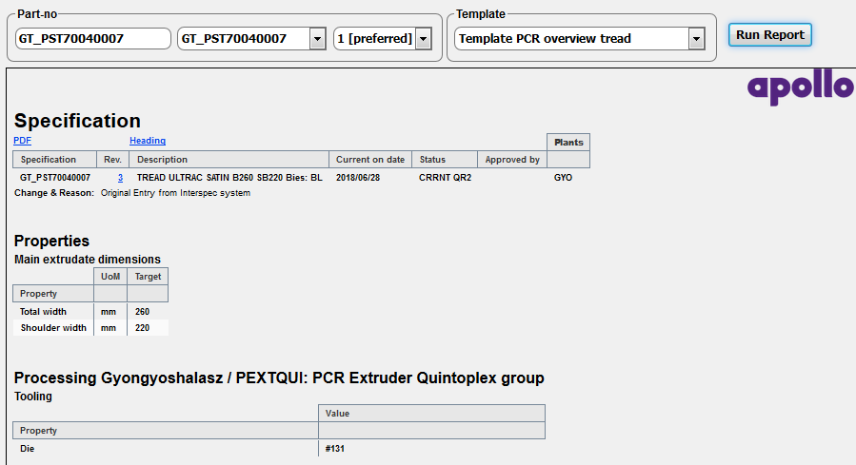
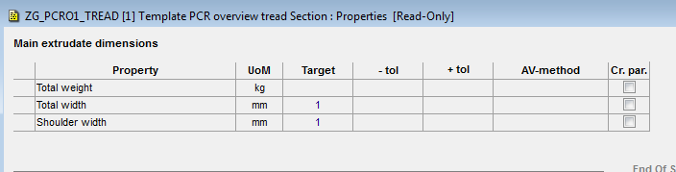
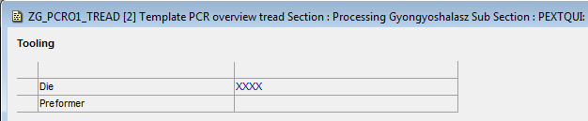
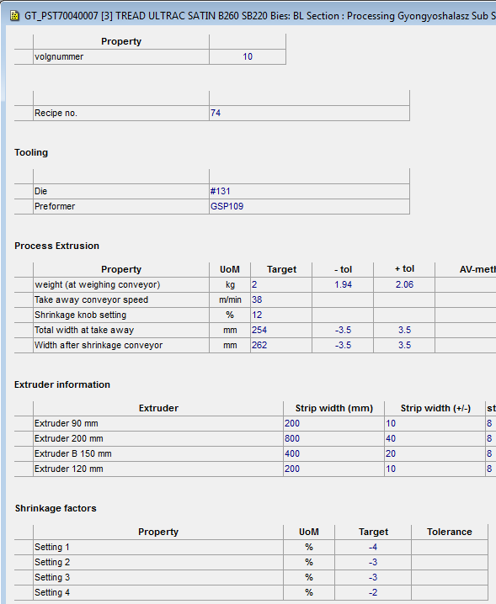
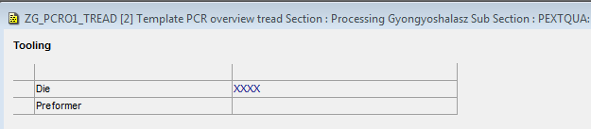
Example Targeted Specification report
Template:
Specificatie:
Targeted spec report:
Keyword “Frame for Athena perspective” indicator for Athena to apply this specification for the indicated frame. Only fields that appear both on the specification and the template are selected (green) . Therefore no Die for “PEXTQUA:” is shown in the report (orange on template)
Data is shown as in Interspec with same structure as in Interspec
Notes:
EF_H185/70R14SP5
ZZ_labels_PCR
GT_PST70040007
ZG_PCRO1_TREAD

Slide 7
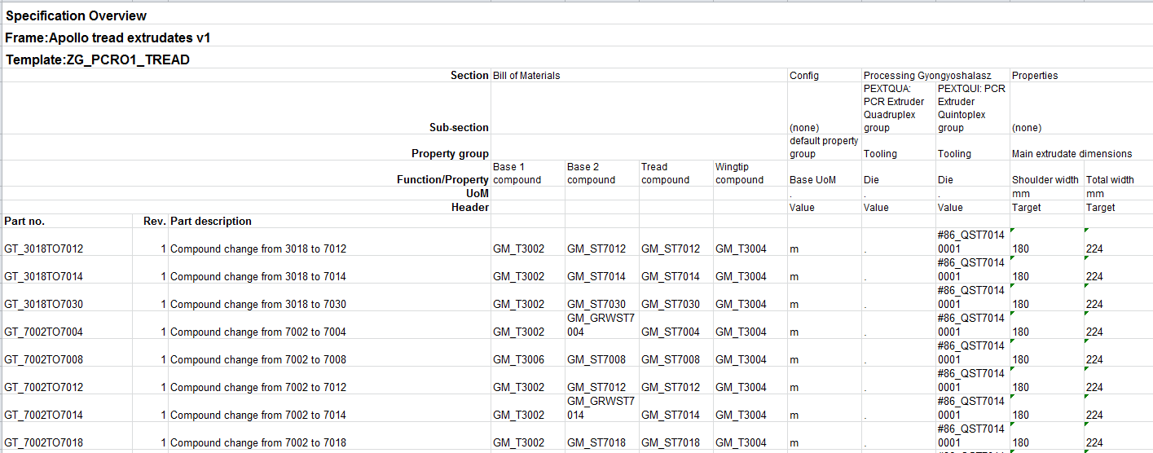
Specification overview
Template:
Specification overview:
Bill of material shows in case a BoM header exists and only shows the materials for a specific function in the BoM, not the quantities

Slide 8
How to create a template
Take a specification from the system in the frame you want to configure data on
To ensure not to be interfaced to SAP, use one or all of the following statements (have Teunis filter them out?)
Use naming convention to store the specification
Testing: ZG_ for GYO, ZZ_ for general, ZE_ for Enschede
Production: QG_ for GYO, QQ_ for general, QE_ for Enschede
Mask_INT<count>* used in GYO
Remove fields in SAP section
Remove the plant from the heading
Change the spec_type into “template”?
Add the keyword “Frame for Athena perspective” with the name of the frame you want to use this template for. You this keyword multiple times so it can cover multiple frame.
First character = Z
Second character = Plant. In case overall second letter = Z
Third character = “_”
Then abreviation of the report
PCR_RnD → Rnd View for PCR
PCRO -> PCR overview
Then a sequence number
Then spec_type (abreviation) the template is for

Slide 9
Configure additional features
Extra keywords in the template can be added to change the functionality of the report:
Report format number (Athena Footer): Will give extra text in header
FPCC header 1: Incidate a first product check card layout and has an additional column with this header
FPCC header 2: Incidate a first product check card layout and has an additional column with this header
FPCC header 3: Incidate a first product check card layout and has an additional column with this header

Slide 10
Displaying/retrieval of BoM data
For a single layer report, the BoM data will be displayed if a BoM header exists
For a multi layer report the BoM data will be displayed if they match the seach string on the concatenation of function codes of a template BoM item.
The data is displayed in
The column mean the following

Slide 11
Multi-level reports: Multi-level specification Specification overview

Slide 12
Background:
Sometimes people need only to retrieve information that is stored on a single specification, but sometimes also information is required that is stored on a specification and information stored under the BoM components of this specification.
Assumption is that you require more information from the top level and less from the lower levels.

Slide 13
Template specifications
Report
Greentyre
Greentyre
BoM
Ply1
Cut ply
BoM greentyre
Ply 1: <Cut ply>
<Composite>
<Reinforc>
<Compound >
BoM
Ply1
BoM
Props
Props
Cut ply
BoM
Composite
Props greentyre (Level 0 components)
Props
Ply1
BoM
Composite
BoM
Reinforcement
Props
Props
Ply 1:
Props Cut ply (templated)
Props Composite( templated)
Props Reinforcement (templated)
Props Compound (templated)
Composite
Props
Props
Reinforc
Reinforc
Ply1
BoM
BoM
Props
Props
Templating rules BoM:
*Search component based on match on function code search string *Only show these that are flagged to be shown
Composite
compound
Compound
Compound
BoM
Ply1
BoM
Props
Templating rules Properties:
Properties: Only show properties and columns that are <> blank in template
Props

Slide 14
Setting up the template
Except for the BoM section, the template setup is exactly the same as for a single level report. The data is represented in three blocks:
BoM (explosion) data merged with property groups with property heading “FUNCTIONCODE”
Assembly properties: All requested properties from the components of in the “BoM explosion” on the selected specification
Top level properties: All requested properties from the selected specification

Slide 15
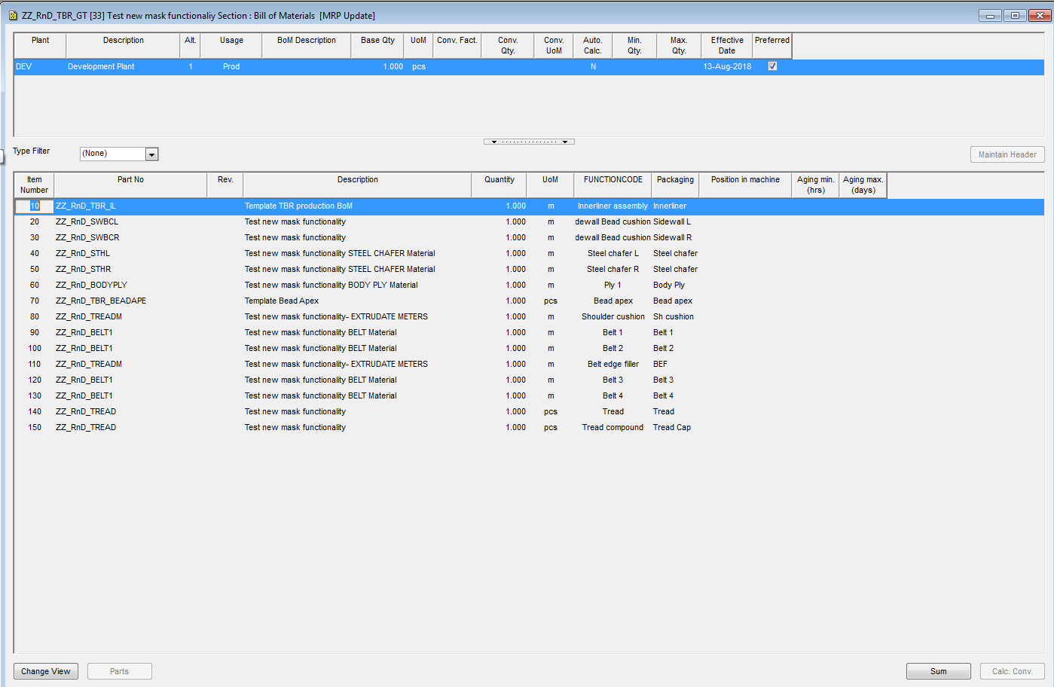
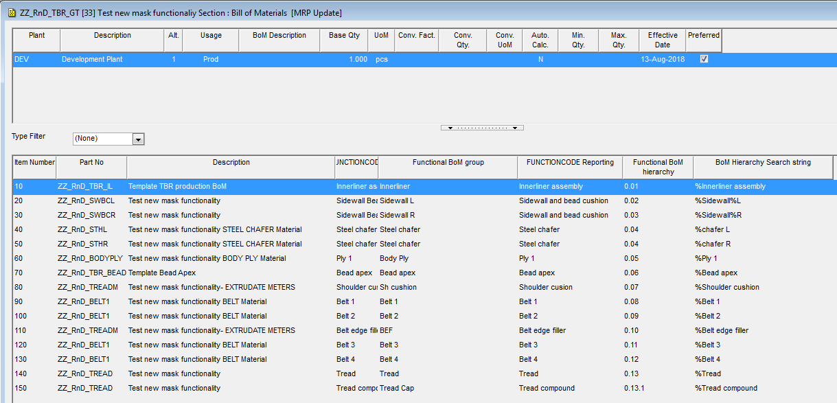
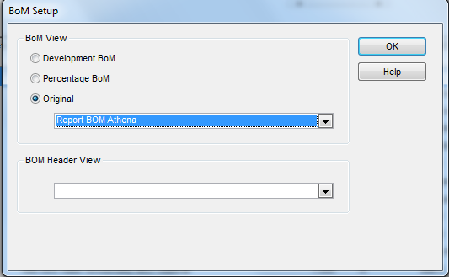
Setting up the template (BoM section)

Slide 16
Setting up the template (1)

Slide 17
Logic of the template (BoM section)
The report will concatenate the FUNCTIONCODES in a BoM explosion of the specification(s) to report on. Via the BoM Hierarchy search string a search is done on this string retrieving the relevant component part no. % is a wildcard in the search string.
For a component partno, Part No in the template BoM specifies the properties to be retrieved from the that specification that matches the
The BoM of the spec that is reported is displayed in the report using Function BoM group as an extra column displayed with the BoM information to specify clearly what is shown.
The FUNCTIONCODE reporting column is the caption that is used to show the properties of the lower BoM levels. This columns is also providing the link between the BoM item and a “FUNCTIONCODE” property (see next slide)
The Functional BoM hierarchy is used for sorting the results

Slide 18
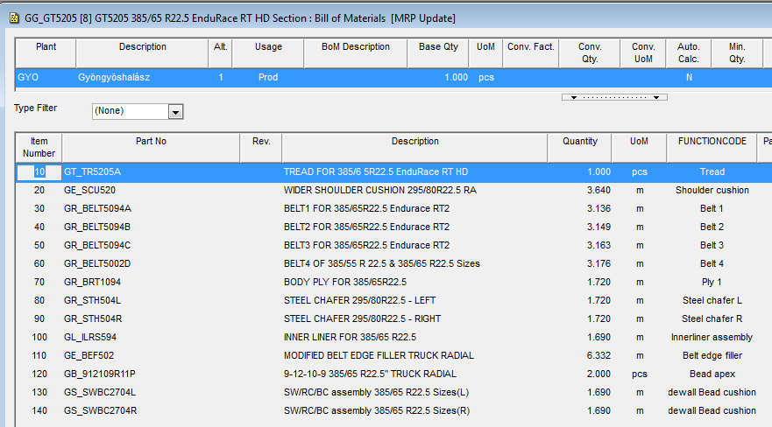
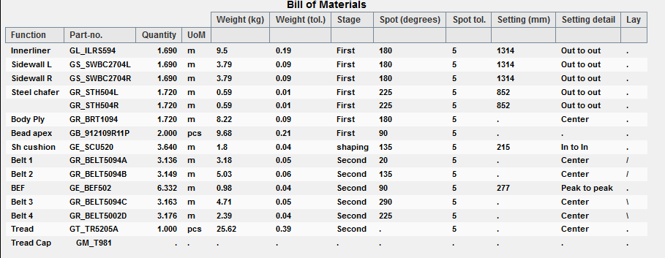
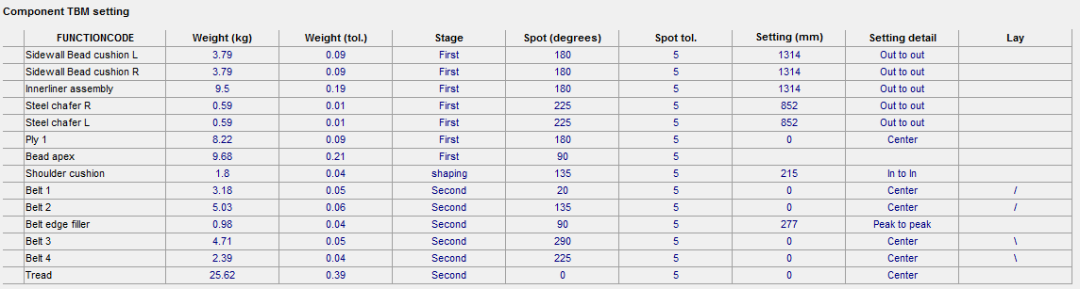
1. Displaying BoM in the report
Template-Function BoM group, sorted by Functional BoM hierarchy
Merge on properties with heading “FUNCTIONCODE” with function code in the BoM
Notes:
GG_GT5205

Slide 19
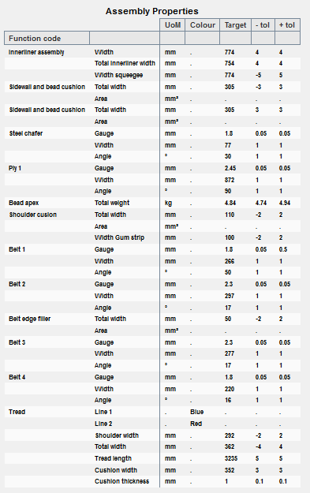
2. Displaying compontent properties
Template-FUNCTIONCODE reporting,
sorted by Functional BoM hierarchy
The matching template determines what fields to be reported from the components. Display in one table showing property only, leaving out section/subsection/propertgroup

Slide 20
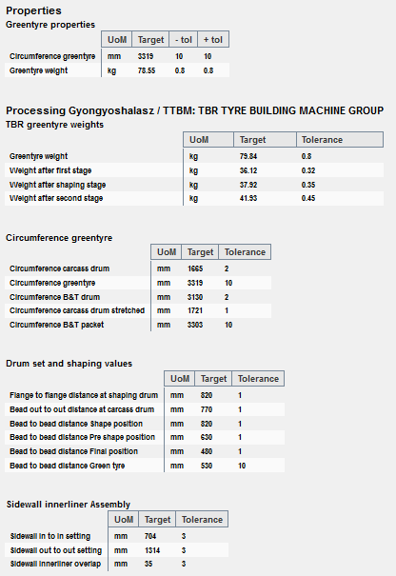
3. Displaying specification properties
Finally the properties are shown on the selected spec. This is handled just like the properties in “Targeted specification” report

Slide 21
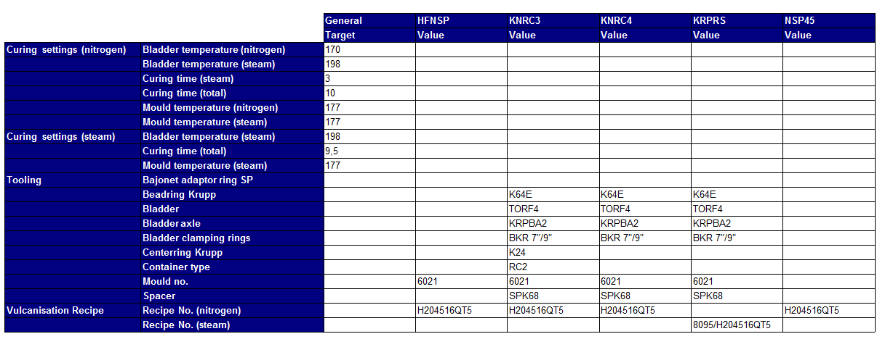
Future addition for specs with various processing groups?
Notes:
This is needed for trials/spec development to check if the settings are correct for the various building machines.
Only visualize a specific set of “display headers” from the subsections “processing in this way” that have column headings........
Put this table directly under the “Processing” section. In case properties remain from other property groups, visualize in the current way

